Slide 1
Serail-2
synchronous serial transmission
For Onboard application
UART ( Universal Asyncronous Receiver Transmitter )
USART (Universal Syncronous Asyncronous Receiver Transmitter )

Slide 2
Synchronous Serial IO (separate clock line)
(onboard application)
1-Usart : Communication with other systems: (Half duplex)
Send a separate clock line with data
------------------------------------------------------------------------------------------------------------
2-SPI (serial peripheral interface) protocol
3- I2C protocol:(Inter-Integrated Circuit Protocol)
Serial EEPROM
Analog-to-Digital Converters
Digital-to-Analog Converters
Display Drivers
Real Time Clocks
Parallel I/O Ports via serial bus
Other special function devices
Serial digital potentiometer

Slide 3
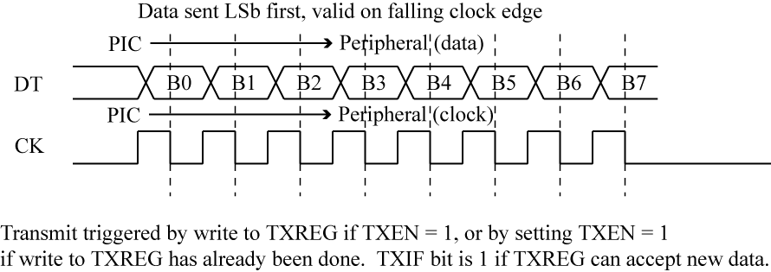
synchronous serial transmission
is possible in three method in 18fxx2
The simplest method in synchronous serial transmission is sending the clock as as a separete signlal. In this way;
1- Hlaf –duplex communication RC6/TX/ as clock, RC/RX/DT (data).. Usart
2- MSSP as SPI Duplex ………… RC3, RC4,RC4, RC5
3-MSSP as I2C Half duplex……. RC3,RC4
MSSP = Master synchronous serial port
USART method:

Slide 4
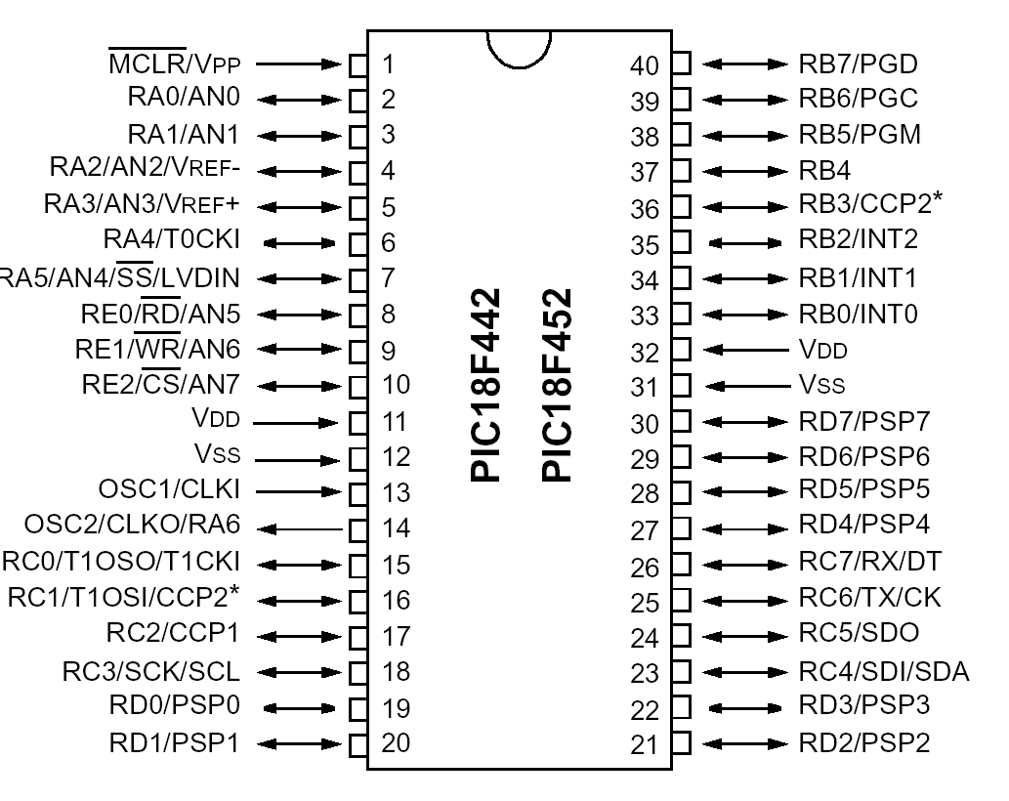
Uart,Usart
MSSP

Slide 5
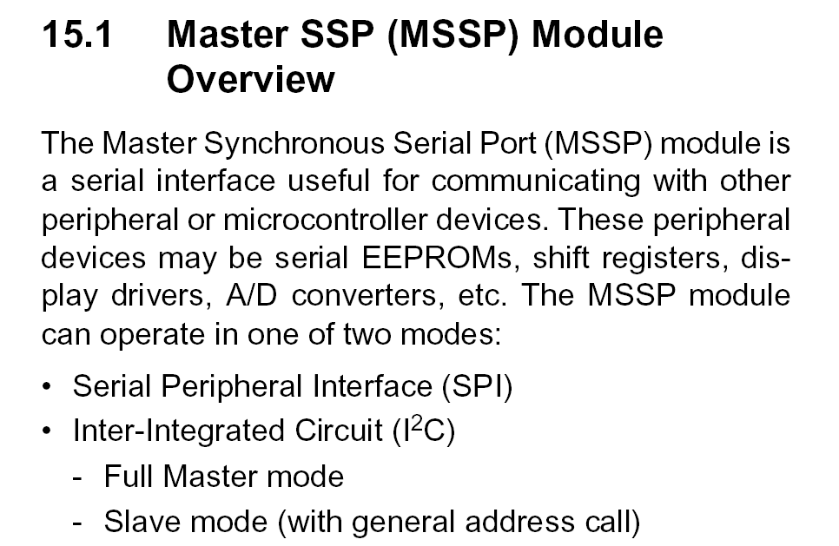
18F452:

Slide 6
Master Synchronous Serial Port (MSSP) module of 18fXX,
REGISTERS
The MSSP module has six registers .
These are:
• MSSP Control Register1 (SSPCON1) : read/write to this register for data transfer
• MSSP Control Register2 (SSPCON2)
• MSSP Status Register (SSPSTAT): read/write to this register for data transfer
• Serial Receive/Transmit Buffer (SSPBUF): read/write to this register for data transfer
• MSSP Shift Register (SSPSR) - Not directly accessible
• MSSP Address Register (SSPADD): used to control clock rate

Slide 7
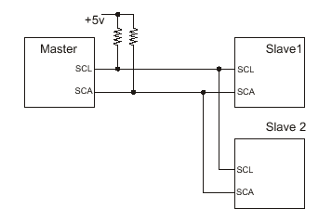
I2C protocol or I2C Bus(Inter-Integrated Circuit Protocol)
The I2C bus is a 2 wire 2-wire, half-duplex serial interface developed by Philips. It was developed for 8 bit applications and is used in consumer electronics, automotive and industrial applications.
The two I2C signals are serial clock (SCL) and serial data (SDA).
SDA (data line) is bidirectional, communication is half duplex
Both lines are bidirectional and must be connected to Vcc via pull-up
The device initiating data transfers and providing the clock signal on the bus is called a "master“
A device being addressed by the master is called a "slave".

Slide 8
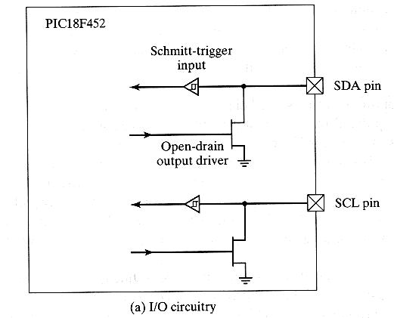
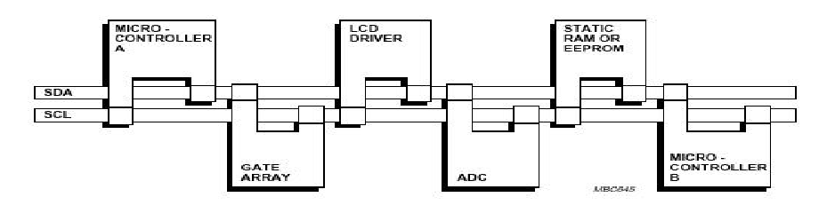
A pull-up resistor is a (usually 1KΩ to 100K Ω) resistor connected between VDD and the wired-NOR wire. In I2C specification, this resistor is 2.2 K Ω.
A variety of devices are available with I2C Interfaces

Slide 9
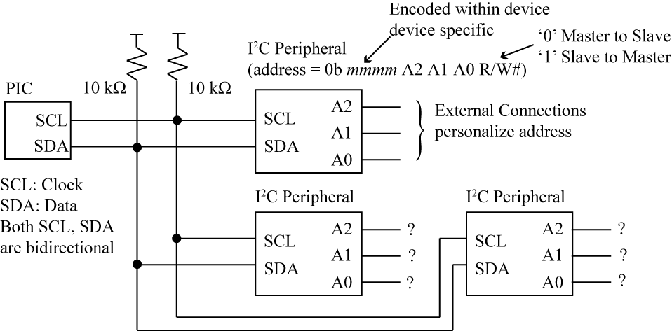
Adressing:
Each device has 7 bit or 10 bit adress. ( this lecture is based on 7 bit adressing)
Uper 4 bits(mmmm) are device specific and coded within the device
The next 3 bits are connected to either Vdd or ground to provide logic 1 or 0
The least segnificant bit of the adress byte ( 8th bit)indicate the direction of transer. “ 0” in write operation and”1” in read operation

Slide 10
I2C Features:
• Multiple receivers do not require separate select lines
– At start of each I2C transaction a 7 or 10 bit device address is sent
– Each device listens – if device address matches internal address, then device responds
• Speeds:
Standard I2C mode up to 100KHz, Fast I2C mode up to 400KHz
Start and Stop Conditions:
Start Condition: The master signals the beginning of a transfer by sending a 1-to-0 transition while SCL is high.
Stop Condition: A 0-to-1 transition issued by the master while SCL is high, signals the end of a transfer.

Slide 11
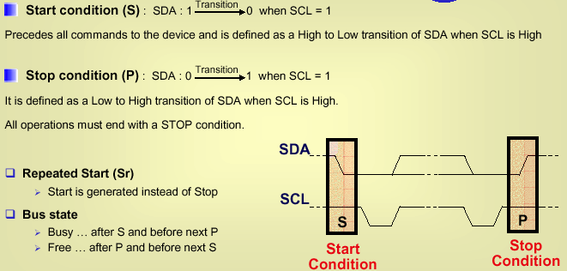
START condition: SDA falls while SCL is high – used by master to signal that the bus is starting a new transaction.
STOP condition: SDA rises while SCL is high – used by master to signal that the bus is entering an idle state.
Idle state: Both SDA and SCL idle high.

Slide 12
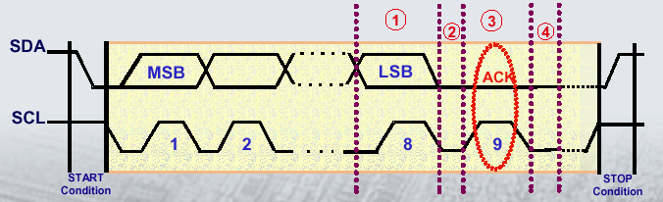
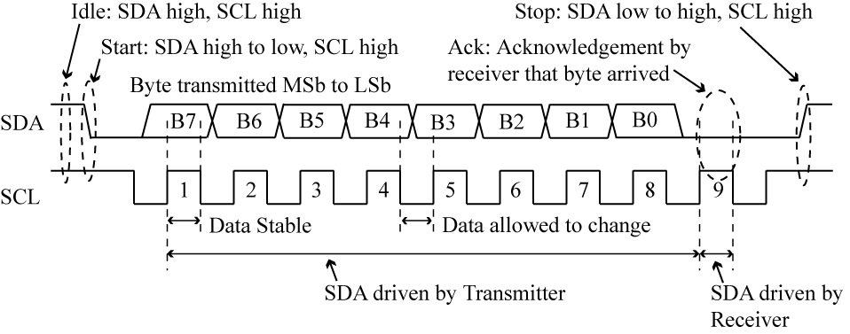
Acknowledgement
After a successful data transfer,each receiving device Master/Slave )is required to generate an Acknowledge: The slave pulls SDA line low immediately after reception of the 8th bit transmitted as soon as the master pulls SCL low to complete the transmission of the bit
Start
Start

Slide 13
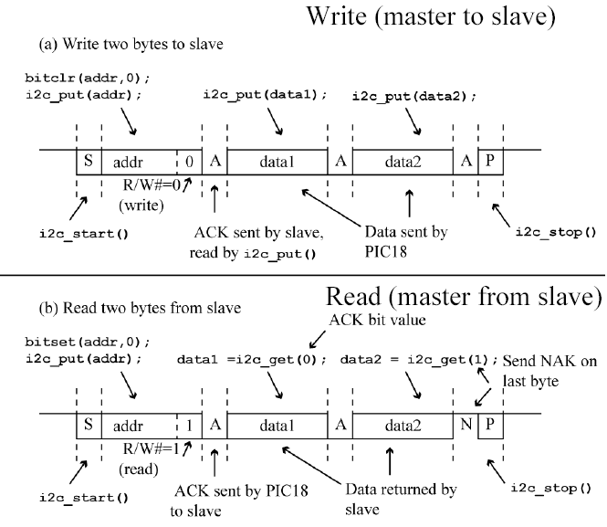
The least segnificant bit of the adress byte indicate the direction of transer. “ 0” in write operation and”1” in read operation
Write
Read

Slide 14
Steps of interface between master and slave:
1. Master sends start condition (S) and controls the clock signal
2. Master sends a unique 7-bit slave device address
3. Master sends read/write bit (R/W) – 0 - slave receive, 1 - slave transmit
4. Receiver sends acknowledge bit (ACK)
5. Transmitter (slave or master) transmits 1 byte of data
6. Receiver issues an ACK bit for the byte received
7. Repeat 5 and 6 if more bytes need to be transmitted.
8.a) For write transaction (master transmitting), master issues stop condition (P) after last byte of data.
8.b) For read transaction (master receiving), master does not acknowledge final byte, just issues stop condition (P) to tell the slave the transmission is done

Slide 15
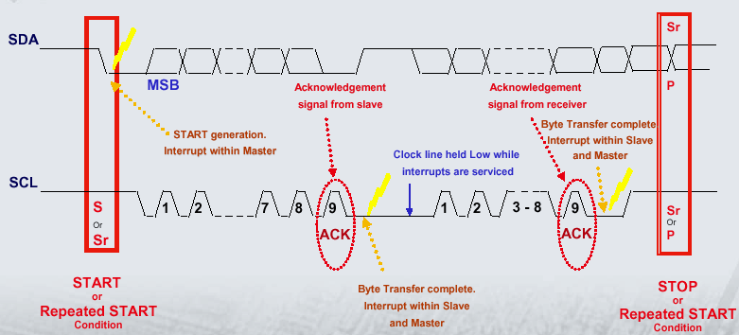

9 bits are sent for each transfer.
First 8 bits are sent by the transmitter – MSb first to LSb last.
9th bit is an acknowledge bit sent by the receiver.

Slide 16
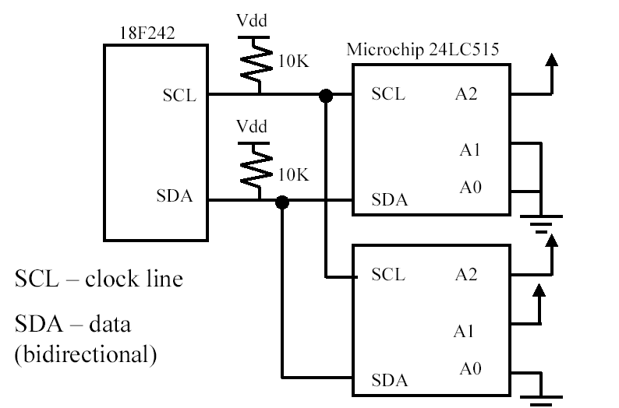
Serial memory: example
24LC515
Has 7 bit adress
Upper four bits are assigned by device manufacturer and are
hardcoded in the device. Lower three bits are used in
different ways by manufacturer.
The 24LC515 is a 64K x 8 serial memory. This would require 16 address lines, and 8 data lines if a parallel interface was used, which would exceed the number of available IO pins microcontroller. Putting a serial interface on a memory device lowers the required pin count. Reduces speed since data has to be sent serially,

Slide 17
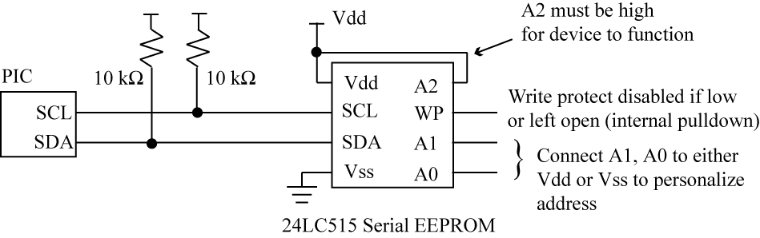
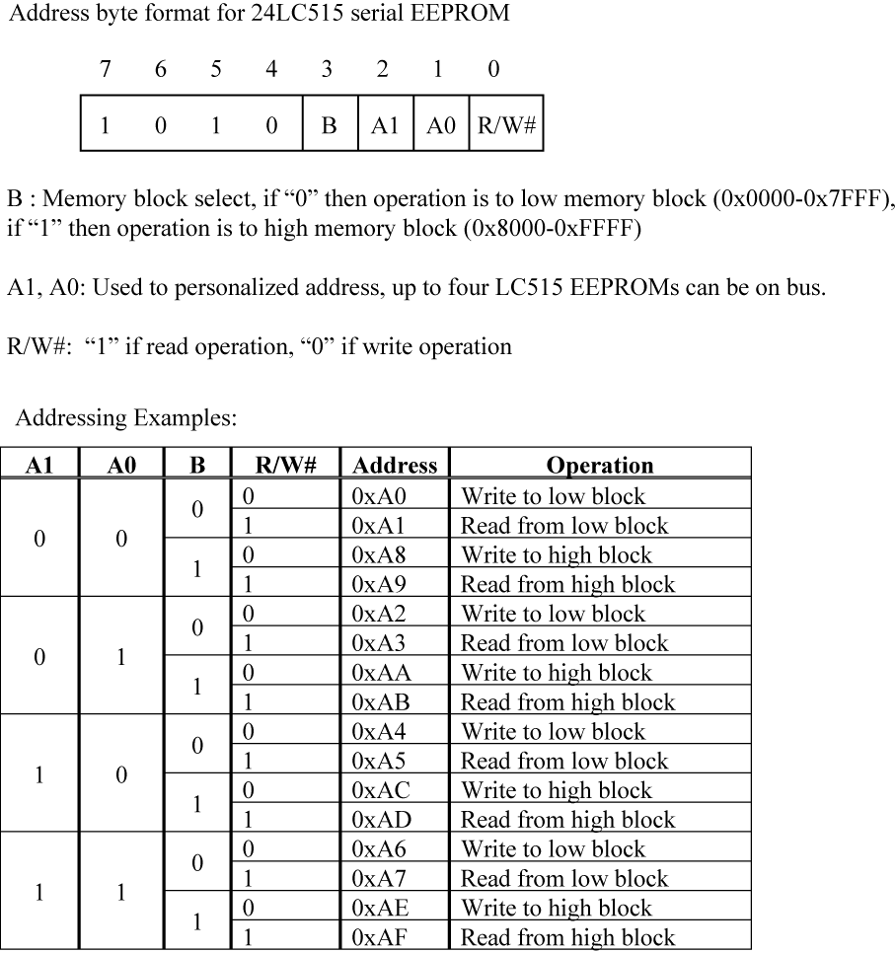
24LC515 64k x 8 serial EEPROM memory, WP (write protect)
64k byte = 16 bit adres bus.. 2⁶ x 2¹⁰ Memory is divided in two block . 32k x2 block

Slide 18
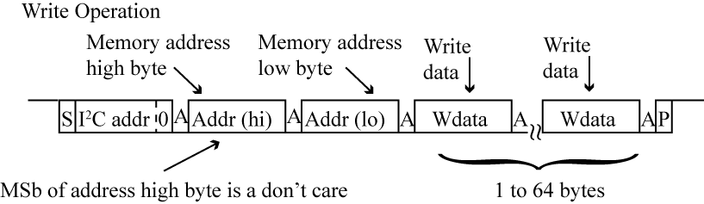
Each block has own 15 bit adres counter
B=0 select of low block
B=1 select of high block
Write operation R/W =0
Read operation R/W =1
A1 A0
0 0 chip one
0 1 chip two
1 0 chip three
1 1 chip four

Slide 19
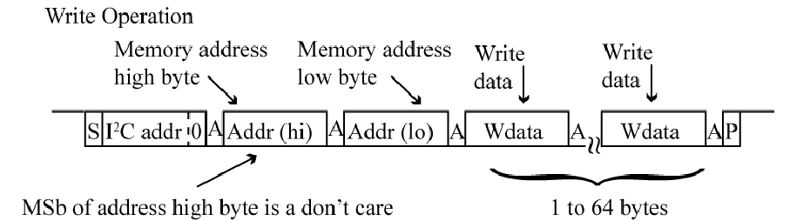
Write Operation – can send up to 64 bytes
• Send up to 64 bytes, then perform write
– Send starting address, followed by 64 bytes
– After 64 bytes sent, wait 5 ms for write to complete
– Much faster than individual writes

Slide 20
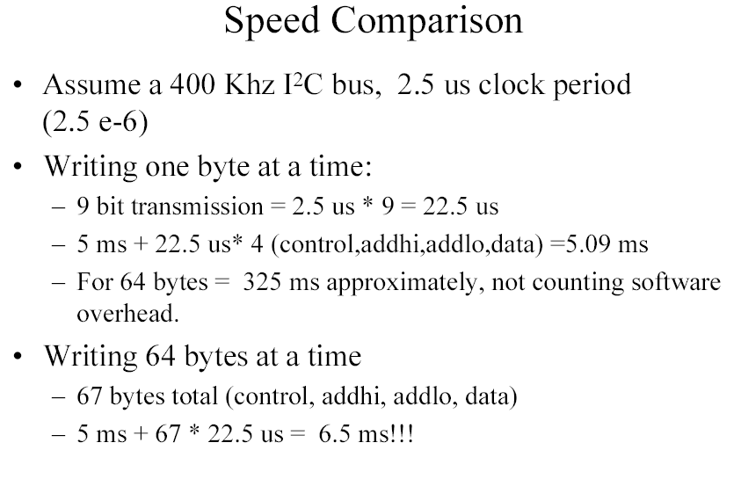
Single byte writing
Block writing

Slide 21
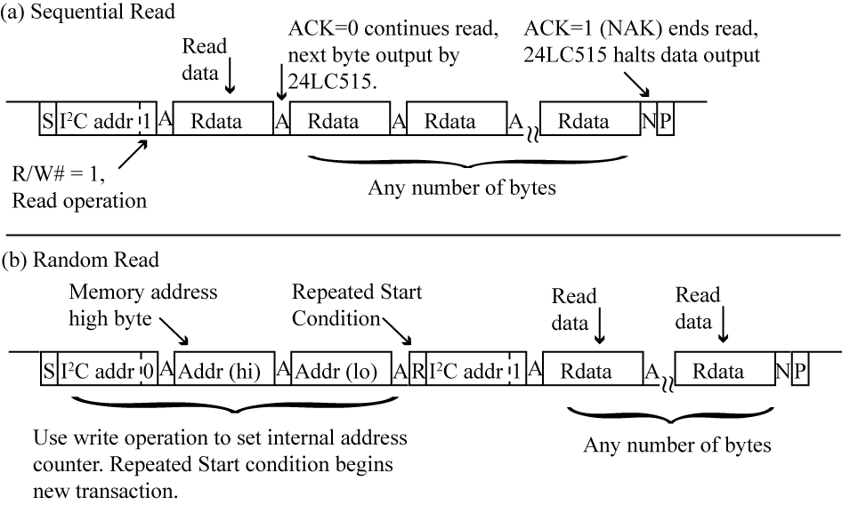
Read operation: for 24LC515

Slide 22
Serial Peripheral Interface (SPI)
The Serial Peripheral Interface (SPI) is a serial communication bus allowing full- duplex
and
synchronous communication in a master- slave system. It can be used to communicate with a serial peripheral device or with another microcontroller with an SPI interface
Data is always transferred in both directions in SPI
Unlike Usart MSB is sent firstly

Slide 23
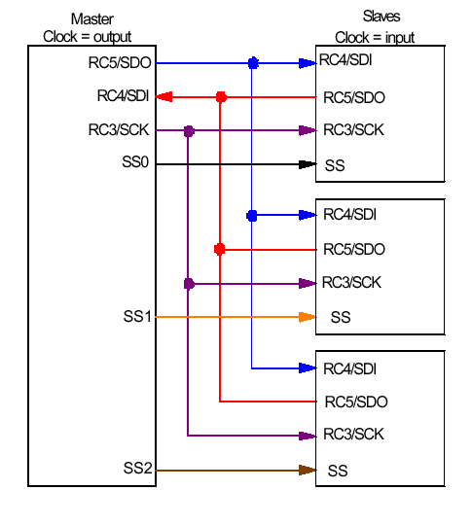
SPI - Serial Peripheral Interface (synchronous serial communication interface: Single master, multiple slave
SPI implementation:
SPI Signals
SCK – the serial clock is and output for the master and an input for all slaves.
SDI – serial data in is an input for both master and slaves.
SDO – serial data out is an output for both master and slaves.

Slide 24
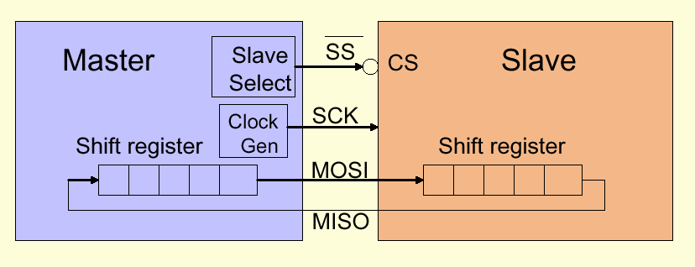
SCLK – serial clock, generated by the master
MOSI – master output/ slave input
MISO – master input/ slave output
SS – slave select/ enable signal
SPI - Master Mode
The bus master controls all communications. The master etermines when data is sent / received
Provides the clock
Provides the SS line (optional). This determines which slave is active.
Writes to the SDO line
Reads the SDI line.

Slide 25
Communication between a master and slave occurs as follows:
Master pulls low the slave select line of the desired slave device. This indicates to each device to prepare for communication.
The Master generates the clock signal according to its SPI mode. Both Master and Slave transmit one bit per clock cycle.
After a byte has been sent the Master pulls the slave select line high.

Slide 26
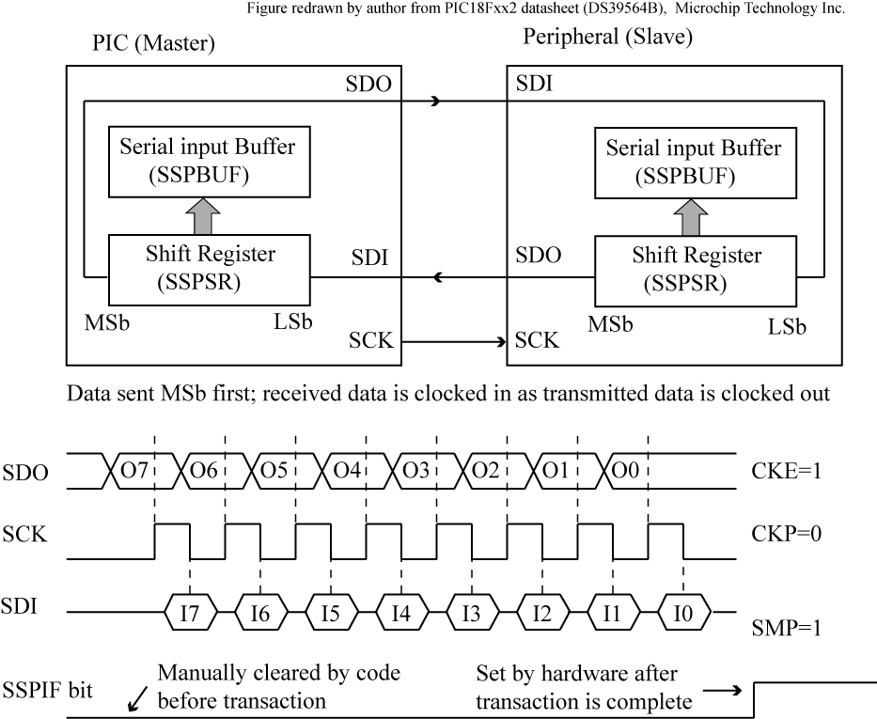
When an SPI transfer is complete, the SSP unit automatically sets the SSPIF bit of the PIR1 register

Slide 27
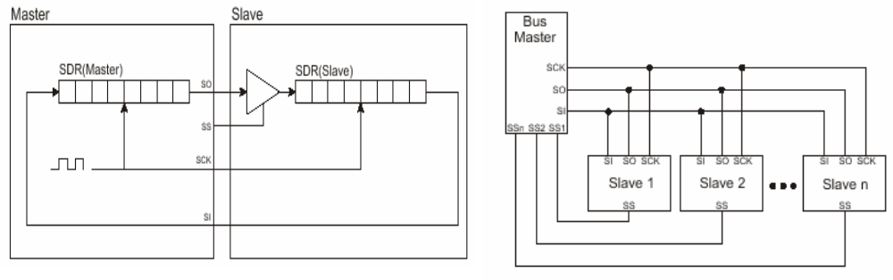
SPI Bus Timing
In operation, the Master and Slave each have an 8-bit data register which are connected together to form a 16-bit shift register. When the slave is selected and the master sends clock pulses the bytes in the master and slave are exchanged.
Typically, the master will put its data on the bus on the leading edge of clock and will latch data on the trailing edge. This results in approximately ½ cycle of available setup and hold time.

Slide 28
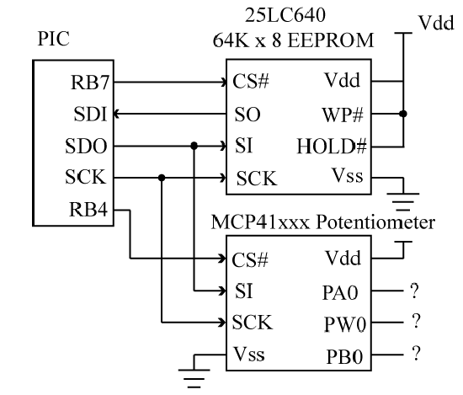
25LC640 SPI memory
Multiple SPI peripherals each require a separate chip select line via parallel port line.

Slide 29
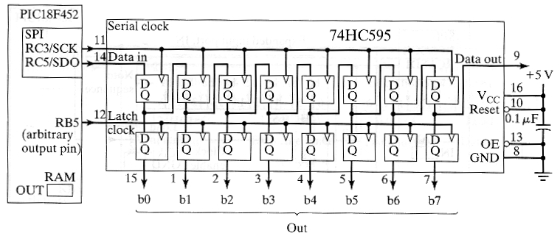
SPI for Output Expansion
If there are not enough output pins on the PIC, 74HC595 serial-in parallel-out shift registers can be used for output expansion.
The 74HC595 is double buffered so that the output pins will not glitch while new data is being shifted out.
An additional general-purpose output pin is needed on the PIC to control the latch clock of the shift register.

Slide 30
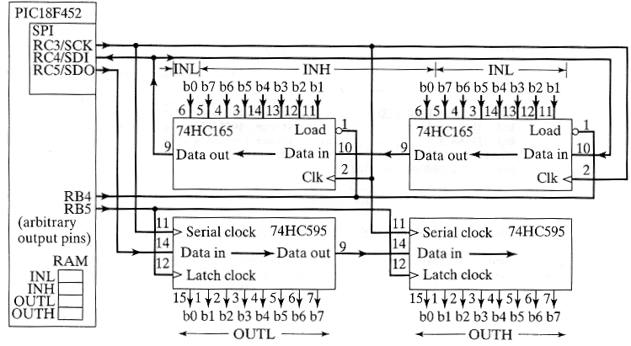
Put All Together Output and Input Expansion

Slide 31
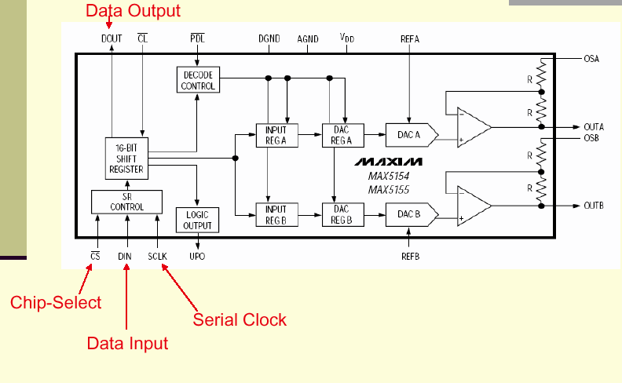
Maxim MAX5154 12- Bit Serial DAC (SPI)

Slide 32
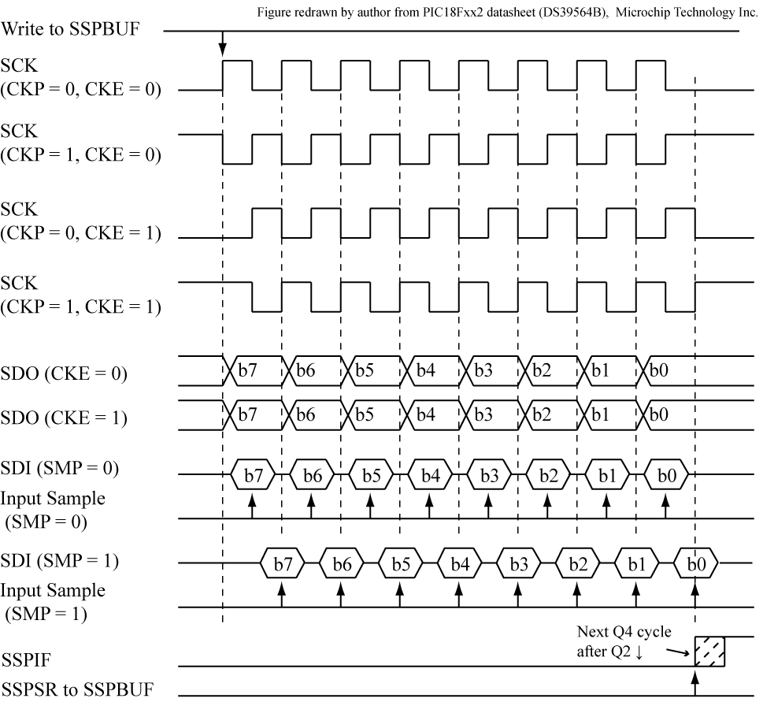
(clock polarity select( CKP), Clock edge select(CKE) and Input sample select(SMP) cases for SPI
CKE configuration
bit allows either
falling or rising
edge of clock to be
used, while CKP
selects clock
polarity. The SMP
bit determines if the
SDI input is sample
in middle or end of
the clock period.

